Slide 1
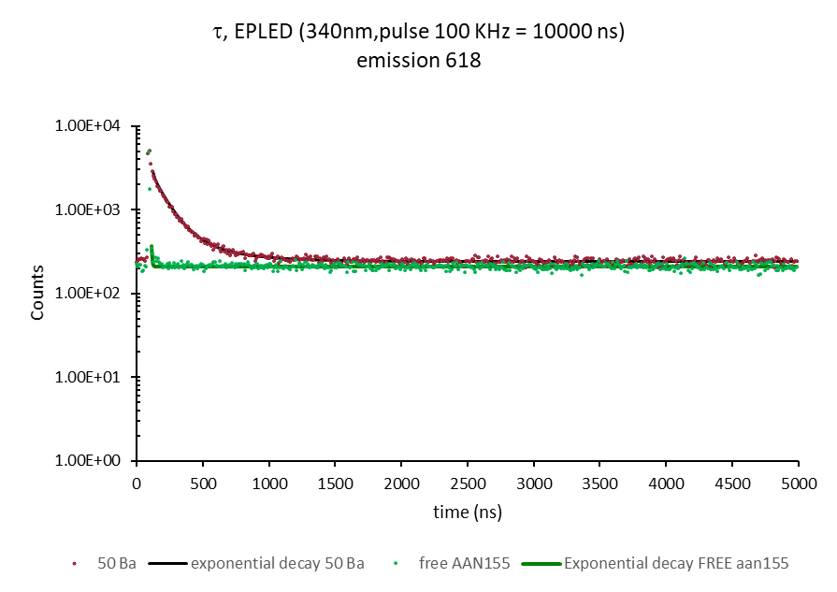
AAN155
AAN155+Ba⁺⁺
TCSPC
MCS
Measured at 502 nm
τ 2.78 ns (100%)
χ² 1.140
Measured at 618 nm
τ₁ 11.5 ns (5.4%)
τ₂ 121.7 ns (67.8%)
τ₃ 379.8 ns (26.8%)
χ² 0.9648
LIFETIME MODE-MCS
AAN155 +50 Ba 618 nm
AAN155 618 nm

Slide 2
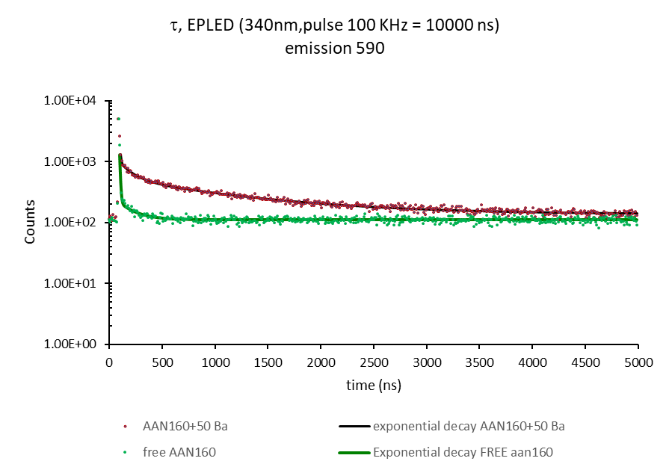
AAN155
AAN155+Ba⁺⁺
AAN160
AAN160+Ba⁺⁺
TCSPC
MCS
TCSPC
MCS
Measured at 502 nm
τ 2.78 ns (100%)
χ² 1.140
Measured at 618 nm
τ₁ 11.5 ns (5.4%)
τ₂ 121.7 ns (67.8%)
τ₃ 379.8 ns (26.8%)
χ² 0.9648
Measured at 500 nm
τ 2.81 ns (100%)
χ² 1.081
Measured at 618 nm
τ₁ 7.0 ns (8.7%)
τ₂ 122.5 ns (11.3%)
τ₃ 1033.8 ns (80.0%)
χ² 0.9648
LIFETIME MODE-MCS
LIFETIME MODE-MCS
AAN155 +50 Ba 618 nm
AAN160 + 50 Ba 590 nm
AAN155 618 nm
AAN160 590 nm

Slide 3
AAN155
AAN155+Ba⁺⁺
AAN160
AAN160+Ba⁺⁺
TCSPC
MCS
TCSPC
MCS
Measured at 502 nm
τ 2.78 ns (100%)
χ² 1.140
Measured at 618 nm
τ₁ 11.5 ns (5.4%)
τ₂ 121.7 ns (67.8%)
τ₃ 379.8 ns (26.8%)
χ² 0.9648
Measured at 500 nm
τ 2.81 ns (100%)
χ² 1.081
Measured at 618 nm
τ₁ 7.0 ns (8.7%)
τ₂ 122.5 ns (11.3%)
τ₃ 1033.8 ns (80.0%)
χ² 0.9648
LIFETIME MODE-MCS
LIFETIME MODE-MCS
AAN155 +50 Ba 618 nm
AAN160 + 50 Ba 590 nm
AAN155 618 nm
AAN160 590 nm

Slide 4
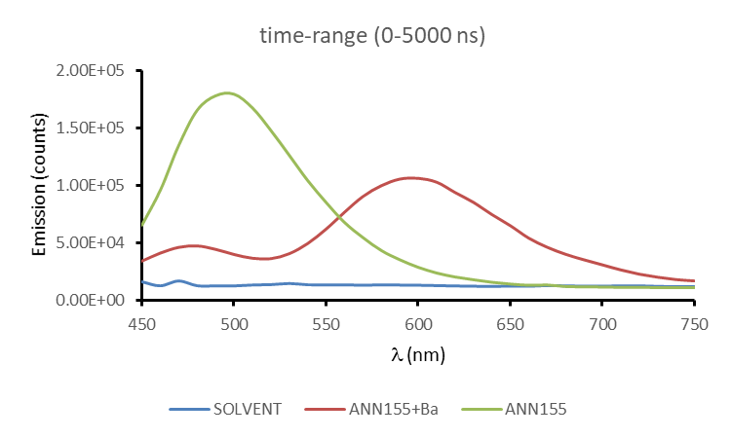
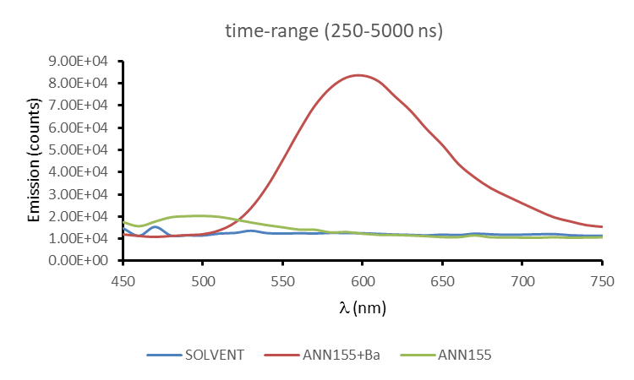
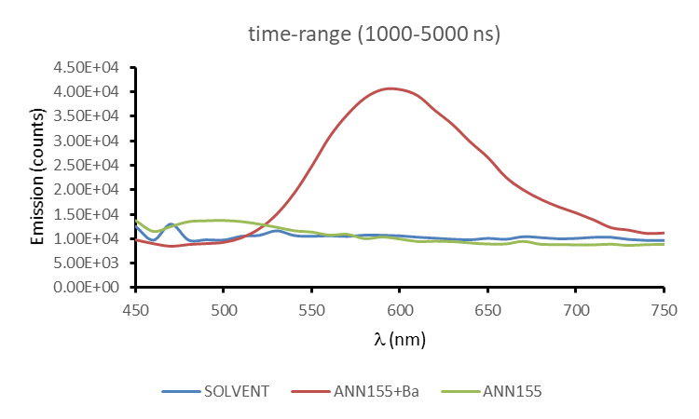
AAN155
AAN155+Ba⁺⁺

Slide 5
Time-resolved emission AAN155
AAN155
AAN155+Ba⁺⁺

Slide 6
Time-resolved emission AAN155
AAN155
AAN155+Ba⁺⁺

